Slide 1



PHASE 1
INTERMEDIATE
DESIGN REVIEW PRESENTATION
by Design Corp.
Prepared for:
EML 4551 Senior Design I

Slide 2

MEET THE TEAM
Aaron Burghardt
  Project Manager, FSU-PC Mechanical Engineering Student (Senior)
Mandolin Brown
  Project Documentation, FSU-PC Mechanical Engineering Student (Senior)
Jack Smith
  CAD Design, FSU-PC Mechanical Engineering Student (Senior)
Matthew Thompson
  Task Assignment, FSU-PC Mechanical Engineering Student (Senior)

Slide 3
RAIN-DETECTION AUTOMATED DOG DOOR
Project Description:
  Automated dog door that can be controlled remotely to limit access to a home’s interior or exterior based on constraints set by the owner such as inclement weather or time.
Project Inspiration:
  Desire to limit and control pet access through home interior and exterior
Objectives:
  Design a dog door that will open and shut on command, limiting pet access through door
  Design door to sense when dog is approaching and open/close if door is unlocked or stay closed if locked
  Sense if obstruction is blocking door from opening or closing

Slide 4
PROJECT PHASES
EML 4551 (Senior Design Project I) encompasses Phase I of project
  January 2023 – April 2023
  Concept selection
  Concept design
  Planning and projected dates
EML 4552 (Senior Design Project II) encompasses Phase II of project
  May 2023 – August 2023
  Prototyping
  Building final design

Slide 5
PAST WORK
Topic Selection
  Rain-detection automated dog door
Work Breakdown Structure (WBS)
  Set work schedule based on EML 4551 deadlines
Functional Decomposition
Benchmarking
  Based on competitor products on market
ROM cost estimates
Concept generation
Proposed concept selection

Slide 6
CURRENT WORK (DESIGN REVIEW 1 TO PRESENT)
Decision matrix (justification of concept selection)
Finalizing calculations for mechanical and power components
  Sizing motor and power requirements
Finalizing CAD rendering of final concept design
  Dimensioned part drawings, assembly drawings
State diagram of system logic
Justification of selected concept and material
Initial sizing
BOM (bill of materials)
Cost estimate

Slide 7
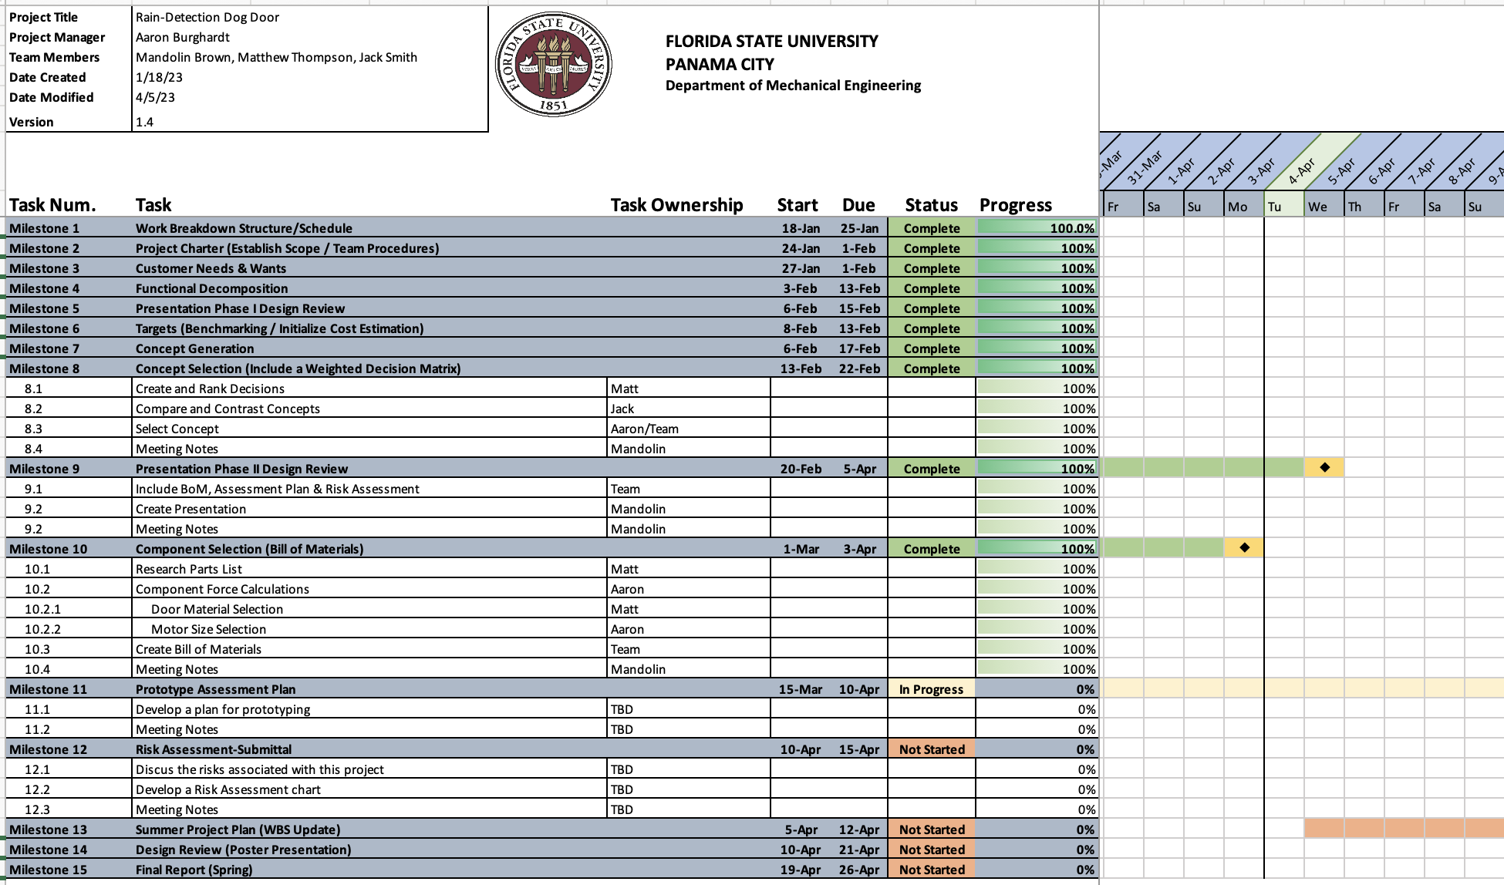
WBS: PROGRESS UPDATE/PROJECTED DATES

Slide 8
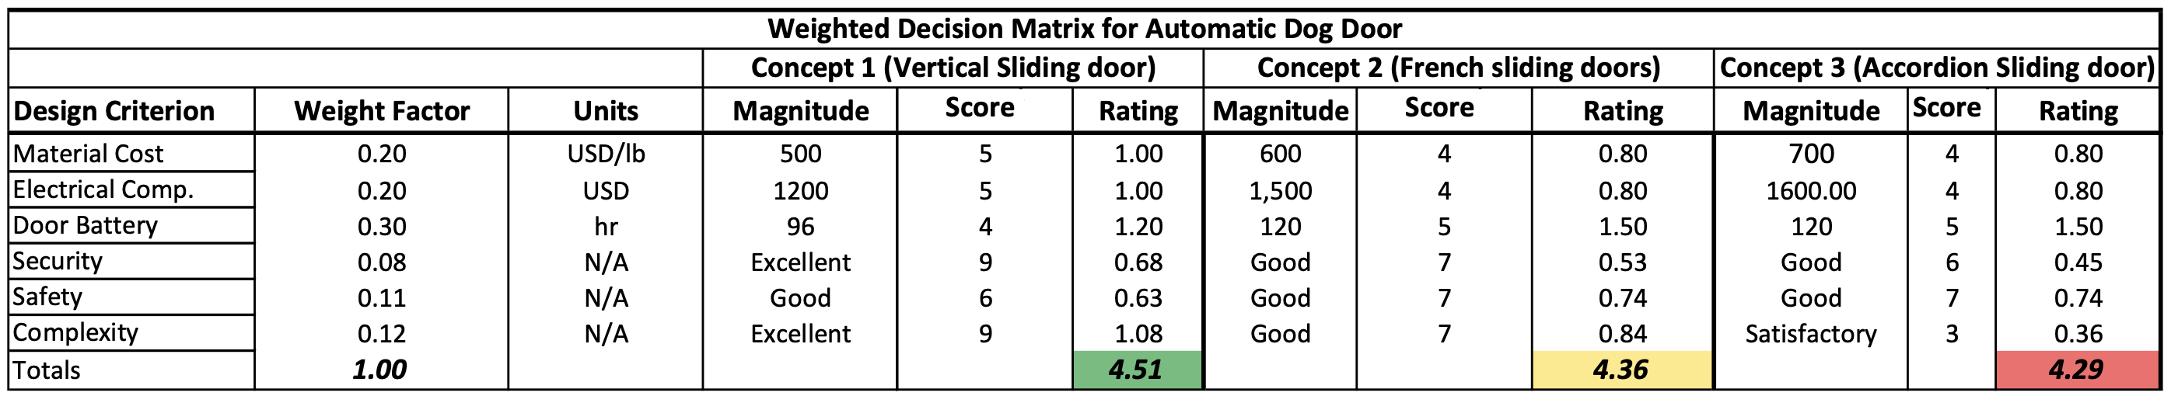
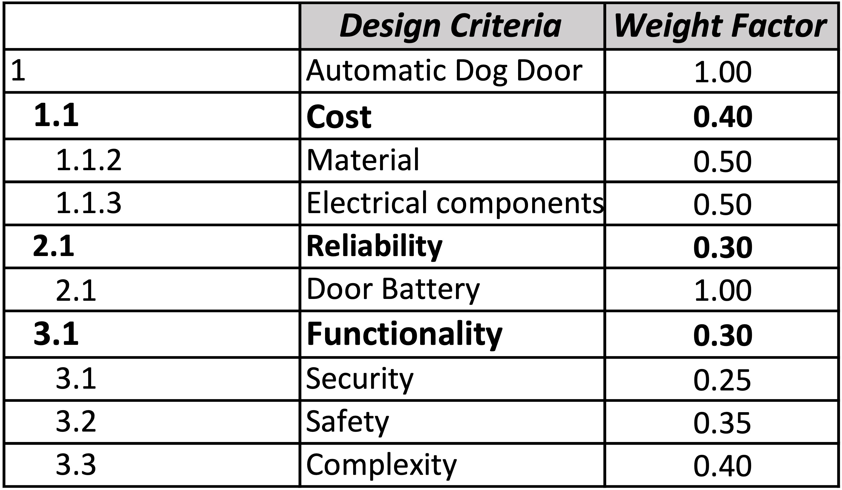
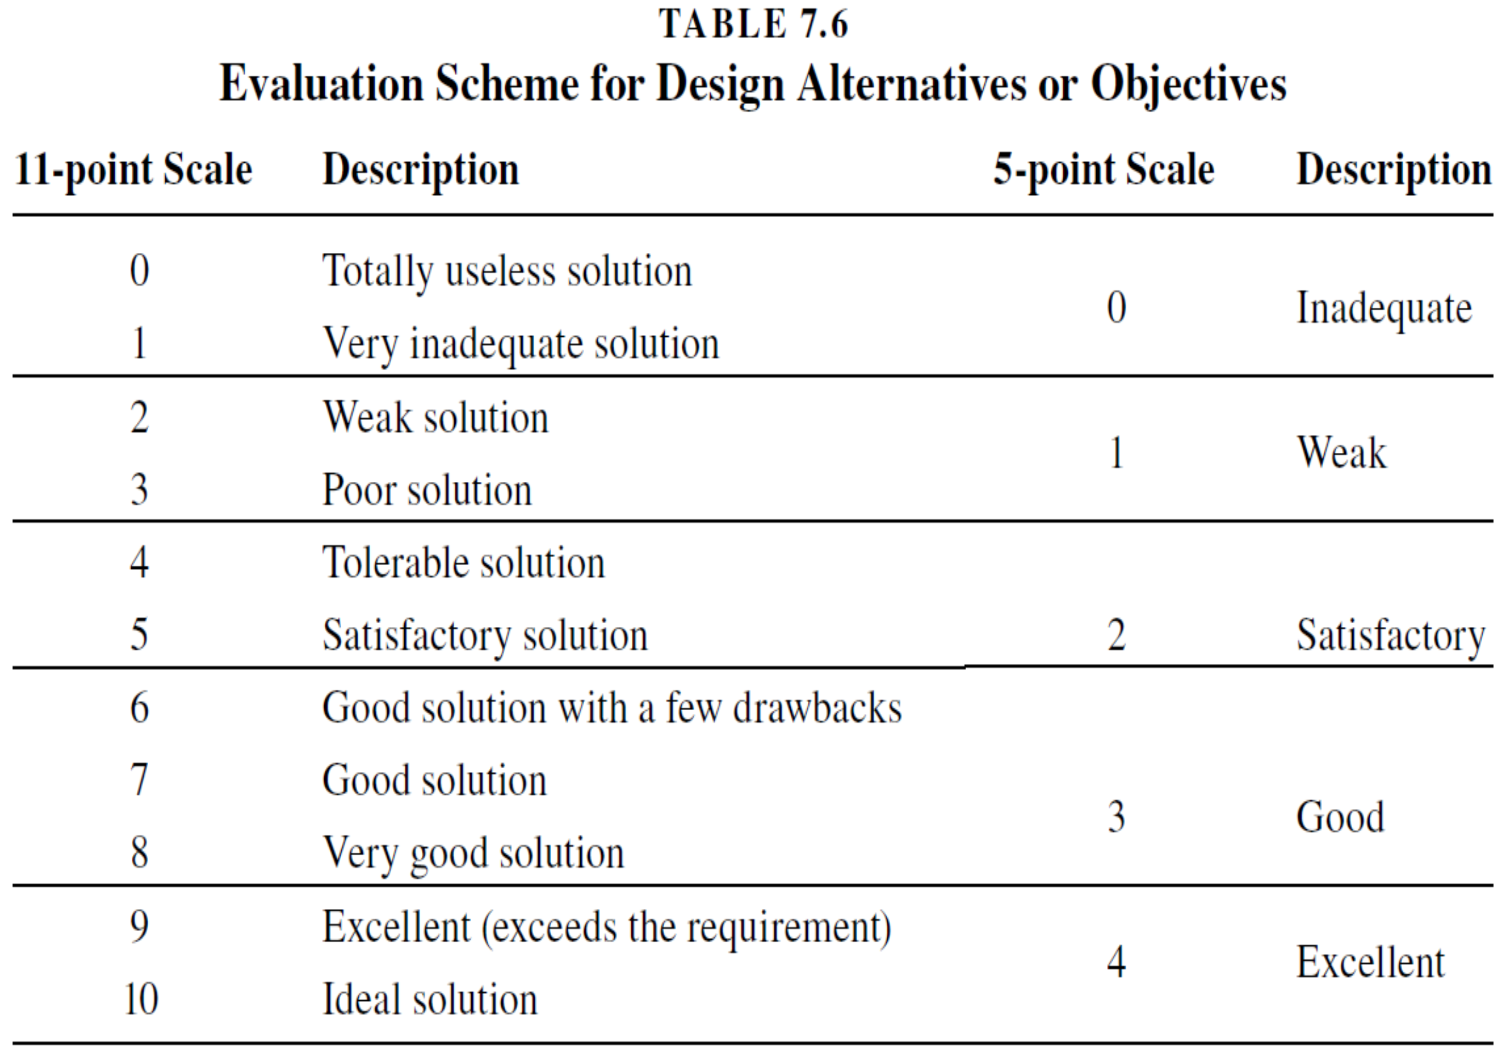
DECISION MATRIX
Selected
Design
Criteria
Design Criteria
Scoring Key^{[1]}

Slide 9
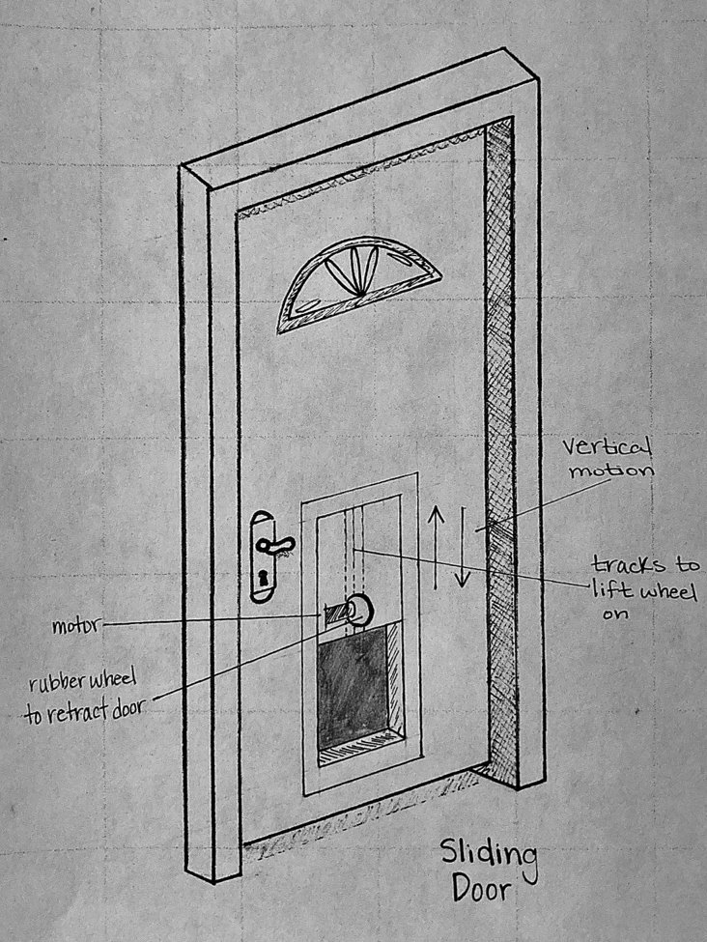
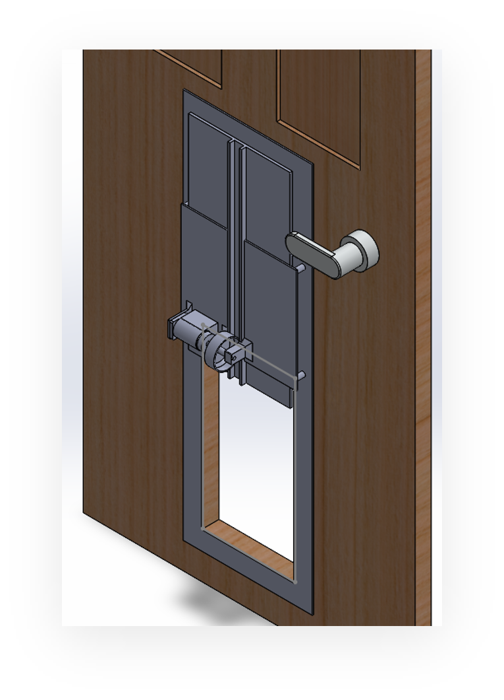
SELECTED CONCEPT
Preliminary concept sketch
Vertical sliding door concept
  Initially preferred concept
  Highest ranking in weighted decision matrix
Best factors of design:
  Low complexity
  Ample security/reliability
Specific design factors are considered from this point
Initial 3D model

Slide 10
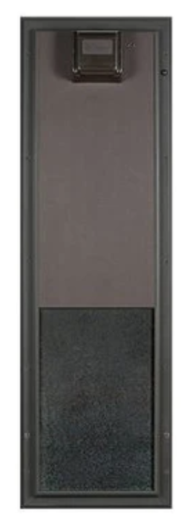
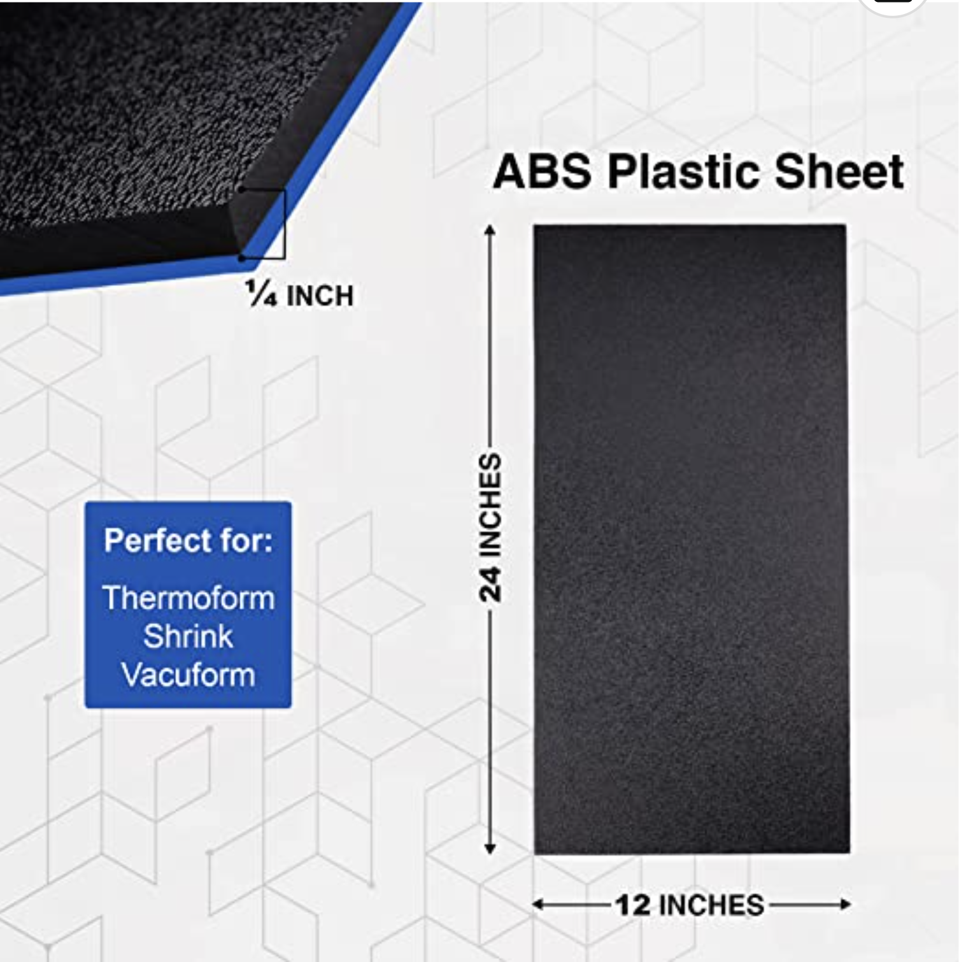
MATERIAL SELECTION AND JUSTIFICATION
Acrylonitrile Butadiene Styrene (ABS) plastic for door^{[2]}
  Tough thermoplastic material
  High impact strength
  Lightweight
  No corrosion (unlike metals like aluminum or steel)
  Cost effective^{[3]}
  Easily accessible^{[3]}
Selected material
Ref. [3]
Competitor model (ABS plastic)
Ref. [4]

Slide 11
MOTOR CALCULATIONS
Requirements:
  Force to lift door of specified weight (as defined by volume and density)
  Torque applied by force and size of friction wheel
  Power to meet these requirements
Motor Requirements
  Motor torque minimum: 1.8 lb_{f} • in.
  Power minimum: 2.6 Watts (0.25hp)
Force Requirements
  Compressive force minimum (no slip condition) : 6 lb_{f}
Notes:
This is calculated with a coefficient of friction of 0.4 and an opening time of 1.5 seconds

Slide 12
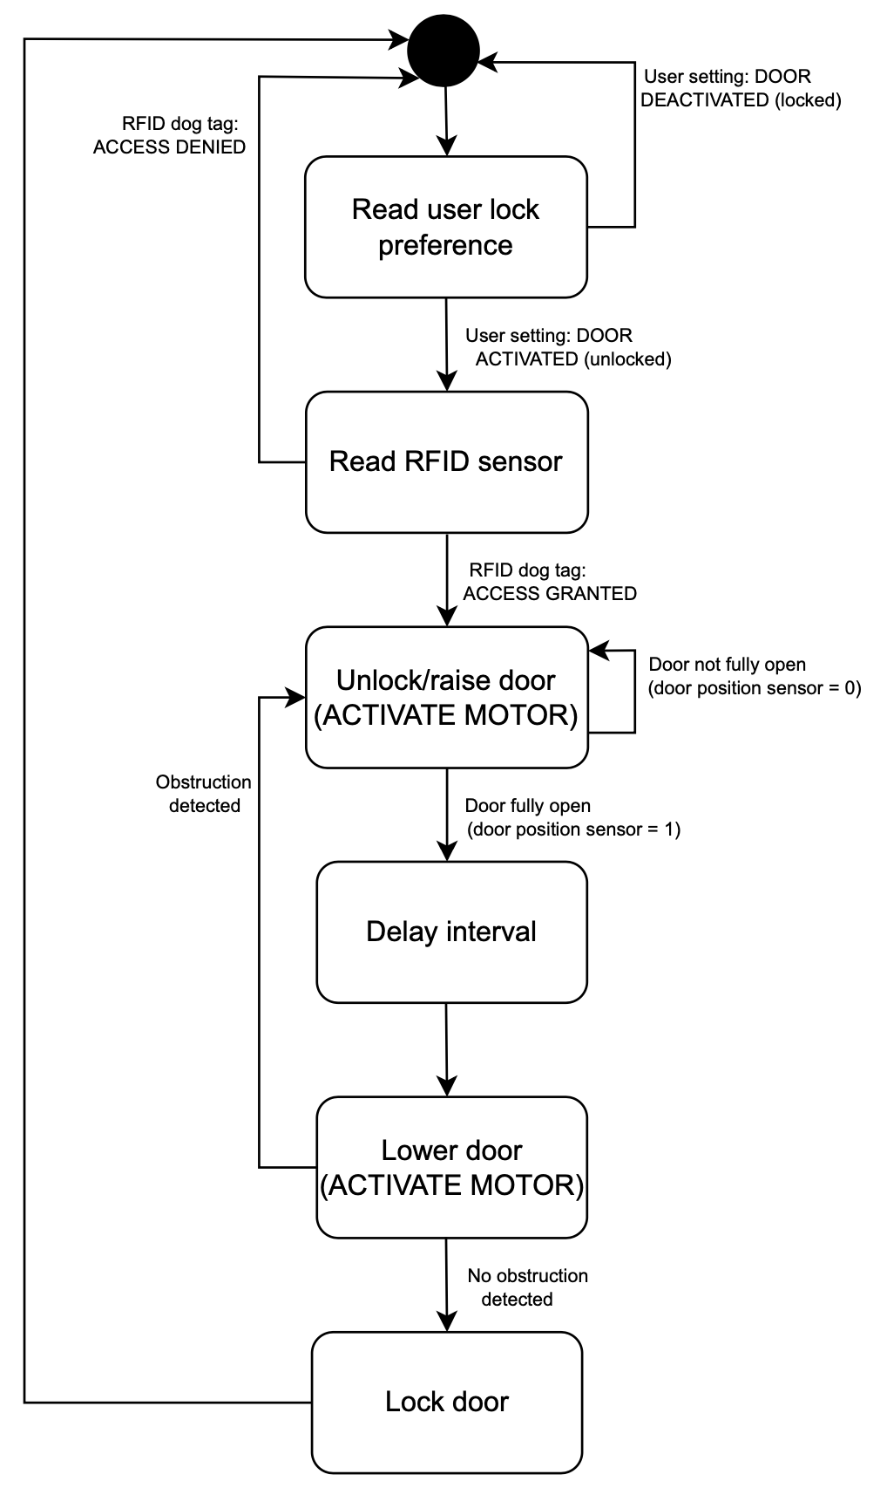

STATE DIAGRAM OF SYSTEM
Arduino software will be utilized to program and automate system
State diagram is based on system logic and overarching functions
  Read RFID sensor
  Motor controls (raise/lower door)
  Lock/unlock door
Specific door constraints are housed within these functions
Notes:
This is calculated with a coefficient of friction of 0.4 and an opening time of 1.5 seconds

Slide 13
ELECTRONIC HARDWARE COMPONENTS
Arduino
  Arduino Uno Rev3 will act as the "brain" of the system to carry out tasks
Sensors
  Detect if door is in the open or closed position
  Detect obstructions in the path of the door
RFID technology
  Trigger door to open and close when in range of the sensors
Battery
  Power the Arduino, RFID Reader, and motor driver for an adequate number of cycles
  Have the ability to recharge for multiple uses
Motor/motor driver
  Require a motor with the necessary torque to slide the door at a reasonable speed

Slide 14
MECHANICAL HARDWARE COMPONENTS
Friction Wheel
  Can be 3D printed to accommodate different sizes for the wheel and other components
  Outer edge will be wrapped with a friction material to produce friction between the wheel and the sliding door
Door
  ABS plastic sheet for easy construction and installation
Housing for electronic components
  Components will be mounted to a 3D printed frame
  A plastic cover will be sized and printed to hide electronics and components
Lock/deadbolt

Slide 15
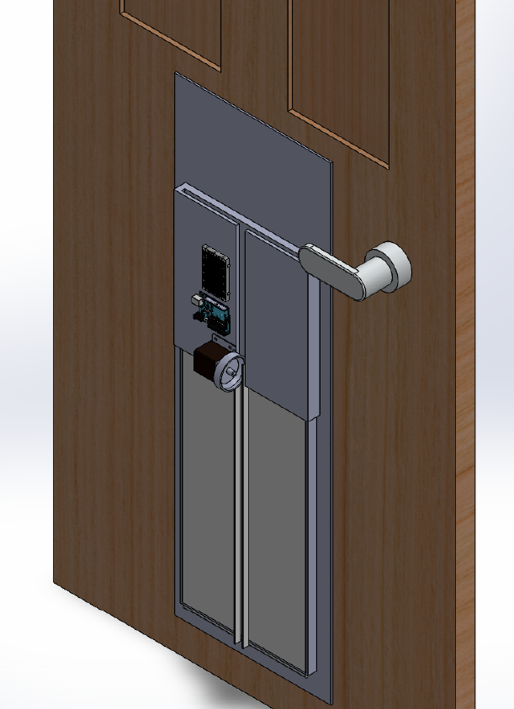
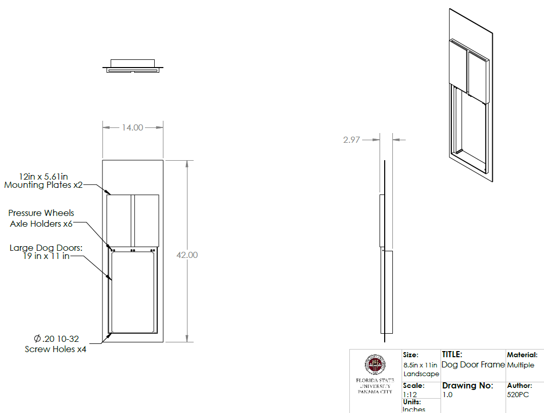
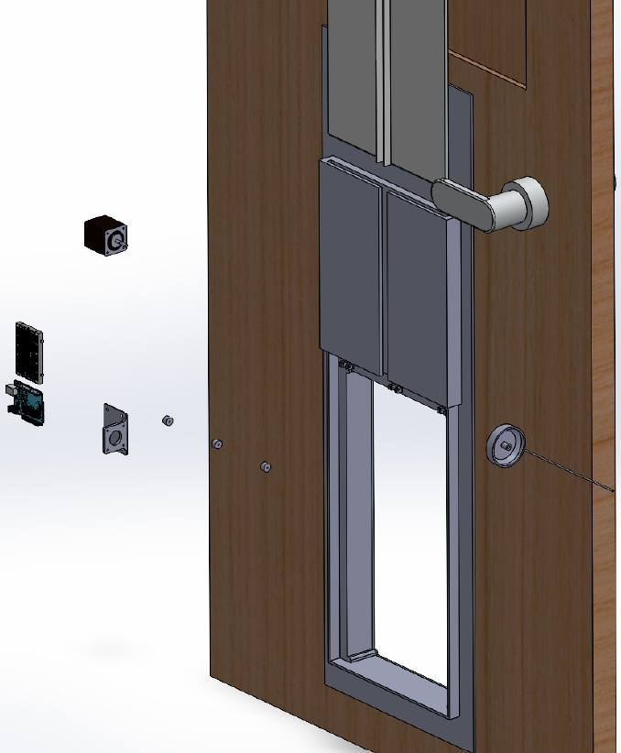
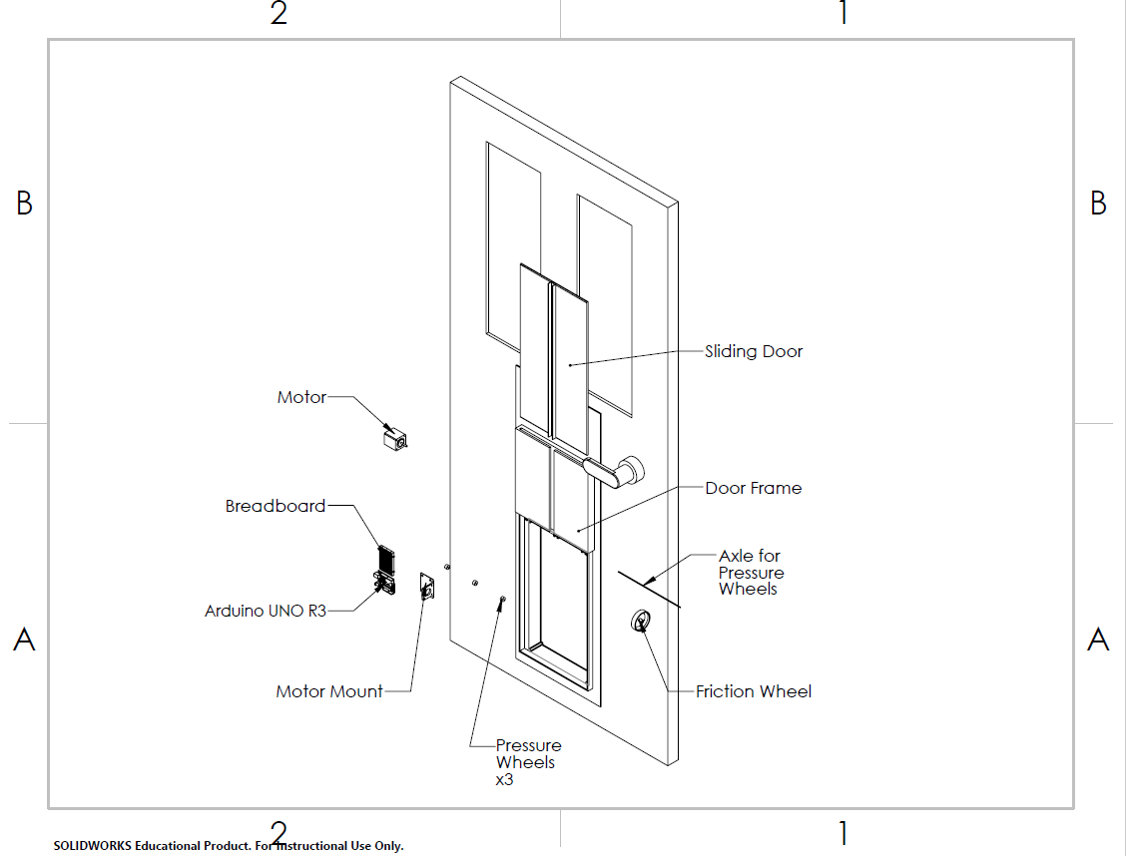

PROPOSED DIMENSIONED DESIGN
Modeled in SolidWorks
Prototype based on drawing files and initial calculations

Slide 16
PROPOSED DIMENSIONED DESIGN
Exploded Assembly View
Dimensioned Frame

Slide 17
PROPOSED DIMENSIONED DESIGN
Supplementary views:

Slide 18
BILL OF MATERIALS
Name | Description | Using this part? | Total Cost/Part | Reference Sheet | Hardware Required
Arduino | Uno Rev3 | Y | $30.49 | Ref5 | 4 Screws 7.85mm long self tap
Arduino/Breadboard wires | Sourced From School Inventory |  | $0.00
Bread Board | Solderless Board Kit |  | $9.98 | Ref7 | N/A 3M adhesive included
Door Lock | Electromagnetic Solenoid Lock |  | $17.48 | Ref8
SparkFun Simultaneous RFID Reader | UHF RFID Reader |  | $235.95 | Ref10
Door Position Sensor | Hinge Lever Switch |  | $8.98 | Ref2
Stepper Motor Driver | Used to make continuous step motor movement |  | $8.58 | Ref11
Obstruction sensor | Laser sensors to detect object in doorway |  | $9.98 | Ref12
Arduino LEDs | Used to display parameters for user |  | $9.97 | Ref9
Friction Wheel | 3D printed/not purchased |  | $0.00
Friction Wheel surround | Grip tape to avoid wheel slip |  | $21.94 | Ref13 | N/A: adhesive
Idle Wheels | 3D printed/not purchased |  | $0.00
Door | ABS Plastic Sheet 1/4" Thick |  | $28.98 | Ref3
Stepper Motor | 59Ncm Bipolar 2A |  | $15.98 | Ref6 | 4 m3 screws
Stepper Motor Mount | 3D printed/not purchased |  |  |  | 4 Screws 7.85mm long self tap
Emergency Funds | 10% of cost of all materials/parts |  | $40.00
 |  | Total Cost: | $438.31

Slide 19
REFERENCES
[1] Dieter, George E. and Schmidt, Linda C. Engineering Design, 5th Edition. New York, McGraw-Hill, 2013.
[2] “Everything You Need to Know About ABS Plastic.” Creative Mechanisms.
  https://www.creativemechanisms.com/blog/everything-you-need-to-know-about-abs-plastic#:~:text=ABS%20is%20very%20structurally%20sturdy,up%20well%20to%20external%20impacts
  Accessed April 2, 2023.
[3] “Duco ABS Plastic Sheet 1/4 Inch Thick 12" x 24" - Two-Sided Rigid ABS Sheet (Textured Plastic Front & Smooth Back) –
  DIY Home Decor and Robotics Competitions Use - Black Plastic Sheet (Pack of 1).” Amazon.
  https://www.amazon.com/Duco-Plastic-Sheet-Inch-Thick/dp/B0BTWKB2NT/ref=sr_1_17?crid=2D8502YHUD6RC&keywords=sturdy%2Bplastic%2Bmaterial&qid=1677533777&s=industrial&sprefix=sturdy%2Bplastic%2Bmaterial%2Cindustrial%2C93&sr=1-17&th=1
  Accessed April 2, 2023.
[4] “PlexiDor Performance Electronic Automatic Door Mounted Cat & Dog Door.”
  https://www.petprosupplyco.com/products/plexidor-pde-door#:~:text=The%20collar%20key%20weighs%20only,ABS%20%2D%20and%20extremely%20durable%20material.
  Accessed April 2, 2023.
[5] “Acrylonitrile Butadiene Styrene (ABS) and Other Specialist Styrenics.” British Plastics Federation.
  https://www.bpf.co.uk/plastipedia/polymers/ABS_and_Other_Specialist_Styrenics.aspx
  Accessed April 2, 2023.

Slide 20
REFERENCES
[6] “Coefficient of Friction Equation and Table Chart.” Engineers Edge.
  https://www.engineersedge.com/coeffients_of_friction.htm
  Accessed April 2, 2023.
[7] “ABS Plastic Sheet - 1/2" Thick x 18" Wide x 18" Long.” Amazon.
  https://www.amazon.com/ABS-Plastic-Sheet-Thick-Wide/dp/B084H1TB7Q
  Accessed April 2, 2023.
[8] Nannestad, Chloë. “13 of the Fastest Dog Breeds in the World.” Reader’s Digest.
  https://www.rd.com/article/fastest-dog-breed/#:~:text=How%20fast%20can%20a%20dog,hour%20for%20a%20short%20distance.
  Accessed April 2, 2023.

Slide 21

QUESTIONS?
QUESTIONS?

Slide 22
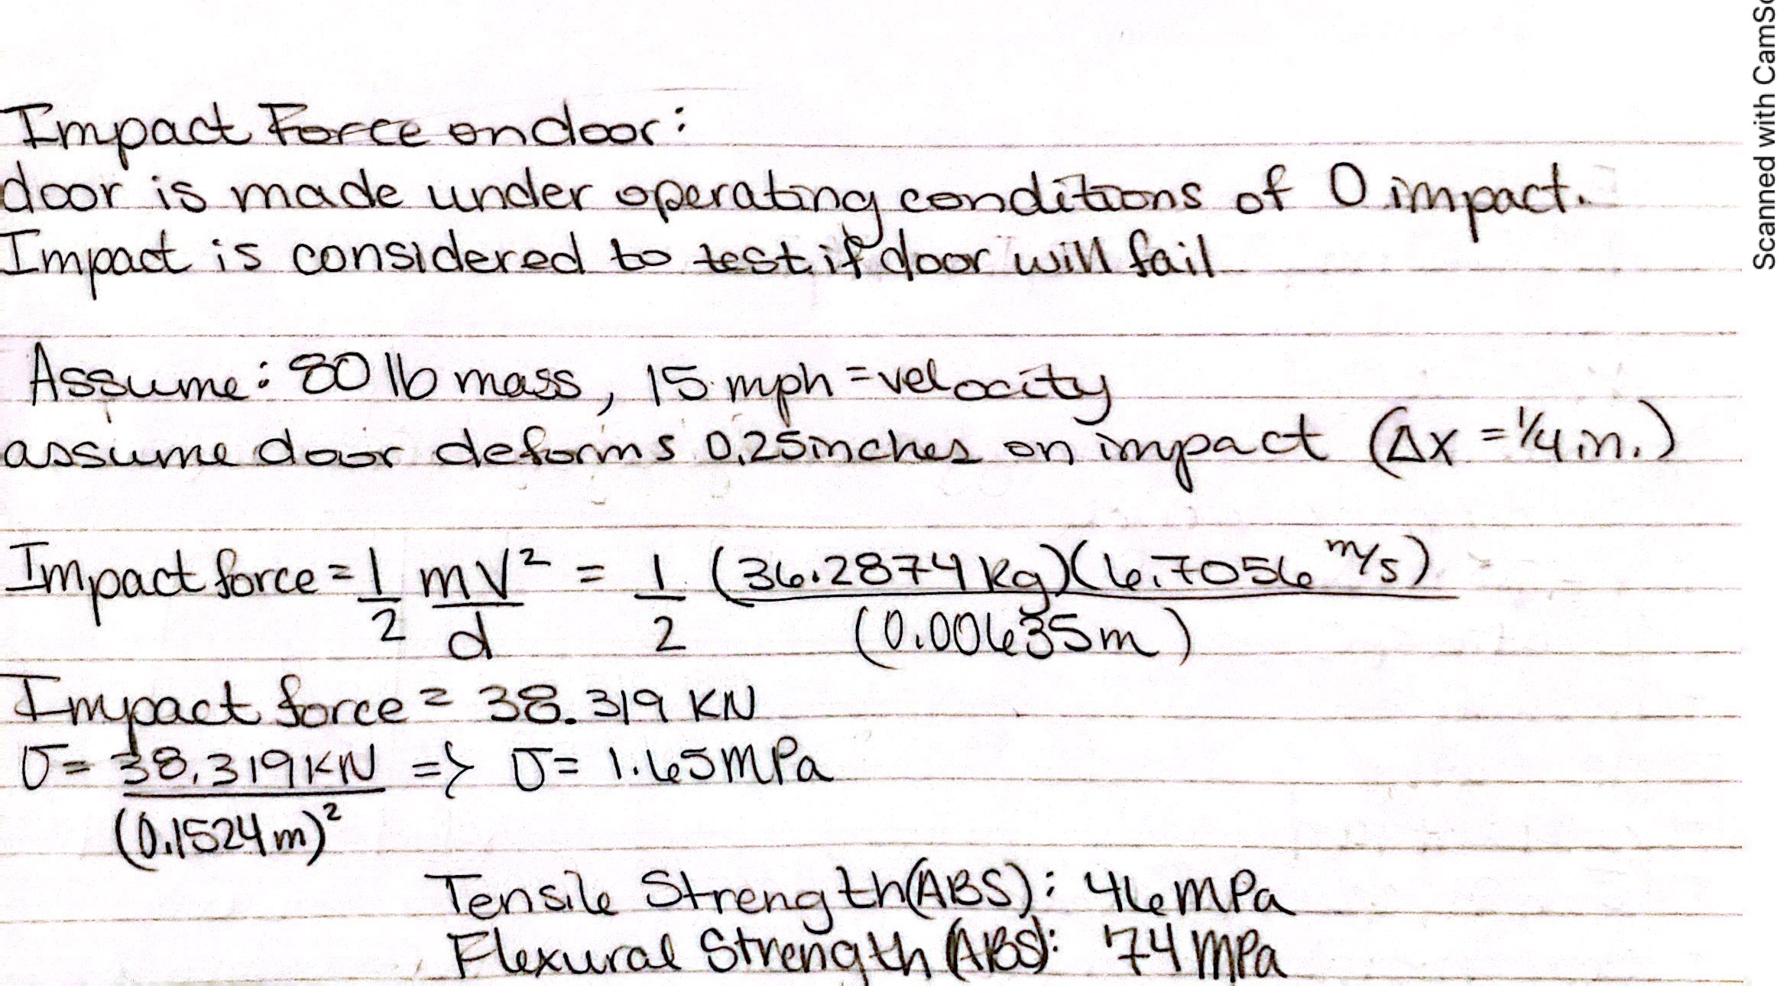
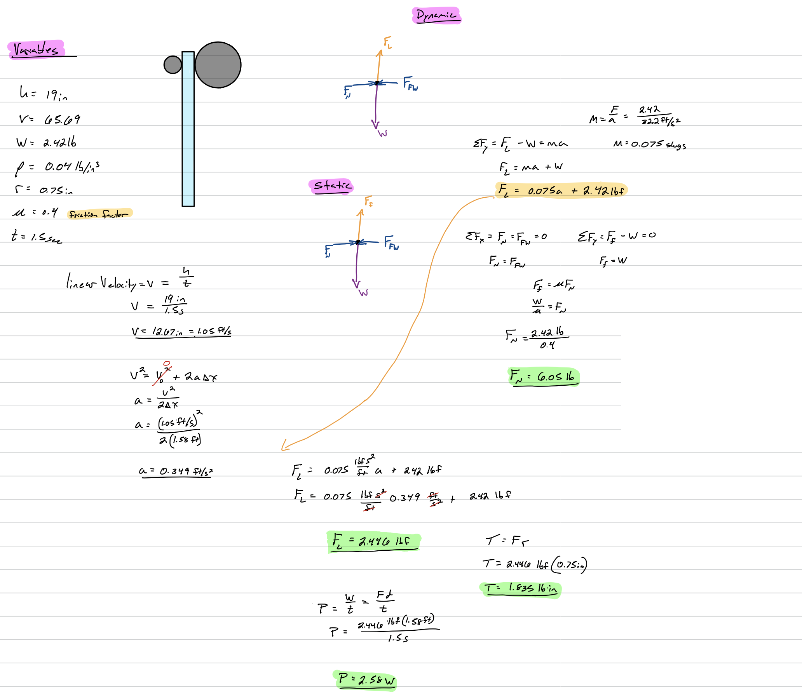
SUPPLEMENTARY MATERIAL
Preliminary impact force calculation
by Mandolin Brown
Preliminary force/power calculations
by Aaron Burghardt

Slide 23
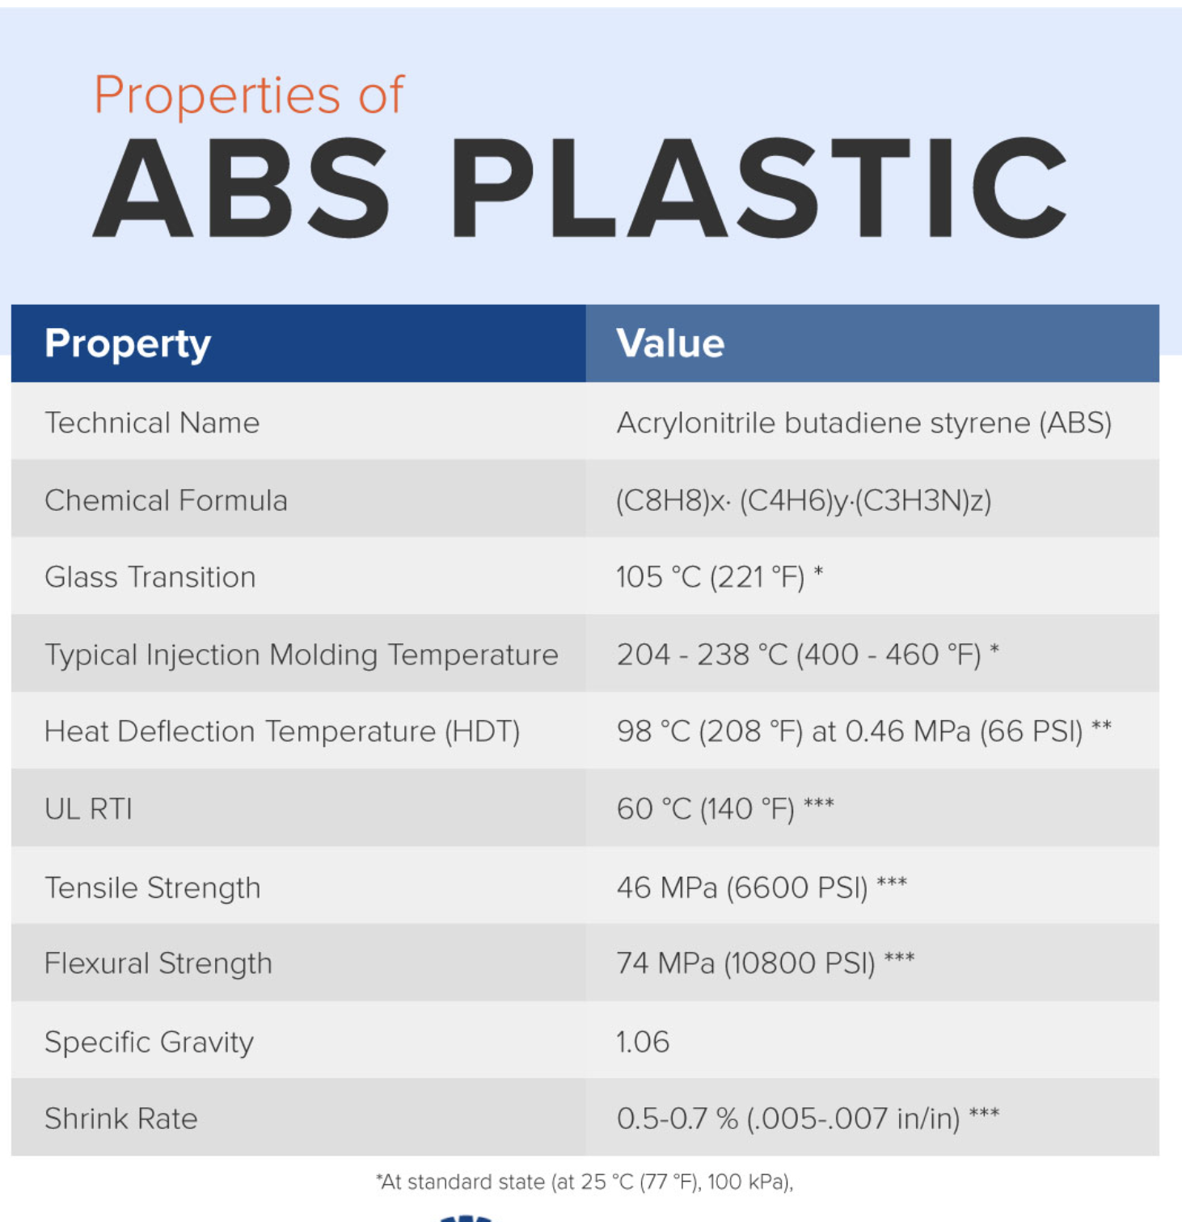
SUPPLEMENTARY MATERIAL
ABS Plastic Properties, Ref. [2]

